Slide 1

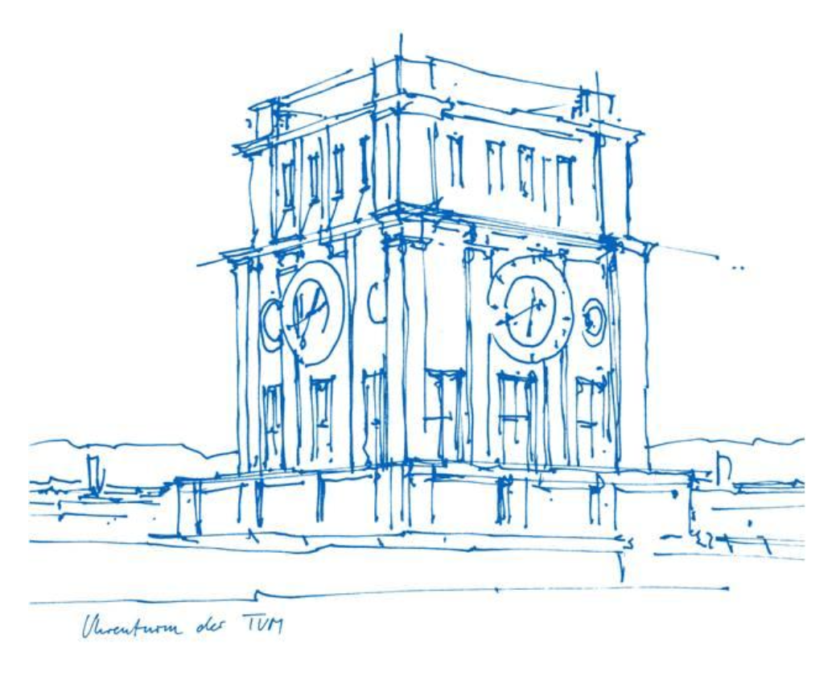
NoCode-bench
Advanced Topics of Software Engineering
Group 4:
Dai Hieu Bui
Haytham Muhamad Sajan
Technical University of Munich
Heilbronn, 02.02.2026
Notes:
Good morning, everyone
Today we’ll present our project NoCode-Agent, an AI-powered system for automatic code generation from documentation changes.

Slide 2
Project Vision
Problem & Motivation
Goals & Innovation
Problem Statement
Documentation updates often precede code changes in software projects
Manual translation from docs to code is time-consuming and error-prone
No automated system bridges the gap between doc changes and implementation
Motivation
Bridge the gap between documentation and code implementation
Reduce developer workload on routine implementation tasks
Improve consistency between documentation and codebase
Goals
Automatically generate code patches from documentation changes
Ensure generated code passes all project tests (P2P & F2P)
Evaluate performance on NoCode-bench Verified (114 instances)
Key Innovation
Multi-phase AI agent with intelligent file location
Context-aware code generation using repo structure
Automated evaluation pipeline with Docker isolation
Robust retry mechanism with fuzzy matching fallback

Slide 3
Project Timeline
Notes:
We began with research and environment setup, then built the core AI agent and backend infrastructure.
Frontend development and integration testing followed in parallel phases.
Right now, we’re moving toward real system integration.

Slide 4
Current Progress
Implementation Status
Key Features
✓
Frontend (100%)
React UI · Real-time status · Patch visualization · Batch control
🔍
Intelligent File Location
AI identifies relevant source files from doc changes
Backend (100%)
FastAPI server · All endpoints · Task pipeline · Thread pool
✏️
Context-Aware Code Gen
Leverages full repo structure for informed edits
✓
AI Agent (100%)
File location · Patch generation · Validation · Token tracking
🛡️
Robust Patch Generation
SEARCH/REPLACE + fuzzy matching (75% threshold)
✓
📊
Real-Time Monitoring
Live progress · 2s polling · Visual batch indicator
✓
Evaluation (100%)
NoCode-bench · Docker eval · Results aggregation · Reports
✅
Comprehensive Evaluation
Docker containers · P2P/F2P · Per-task failure analysis
✓
Infrastructure (100%)
Repo isolation · Workspace mgmt · Cleanup · Error recovery
🔄
Error Resilience
Auto-retry (3×) · Graceful recovery · Cost tracking

Slide 5
System Architecture
USER INTERFACE
TaskList: Browse & search 114 benchmark tasks with color-coded status
TaskDetail: View problem statement, generated patch and metrics
BatchControl: Start/stop batch processing with real-time progress bar
BACKEND API SERVER
State Management: In-memory task storage and result caching
Service Orchestrator: Coordinates task execution and batch workflow
REST API: /tasks, /run, /batch/start/status/stop, /results endpoints
AI AGENT LAYER — NoCodeAgent
Phase 1 - File Location: gemini-pro identifies edit vs. context files
Phase 2 - Patch Generation: SEARCH/REPLACE blocks with fuzzy fallback (75%)
Phase 3 - Validation: Syntax check + git-apply verification, retries up to 3×
EVALUATION LAYER
Test Execution: P2P & F2P tests in isolated Docker containers (300s timeout)
Metrics & Results: Resolution rate, token usage, file accuracy tracking
Output: all_preds.jsonl → evaluation_details.jsonl → summary_report.txt

Slide 6
Evaluation
METHODOLOGY
REQUIRED METRICS
TEST CATEGORIES & TARGETS
Framework: NoCode-bench · 114 verified instances with ground-truth solutions
Success%: Resolution rate
P2P: Pass-to-Pass: Tests passing before and after patch
Step 1: Generated patch applied to repo at base_commit
Applied%: Patch application rate
P2P Target: 100% pass rate - no regressions allowed
#Token: Prompt + completion breakdown
Step 2: Test suite executed in isolated Docker container (300s timeout)
F2P: Fail-to-Pass: Previously failing tests now pass
RT%: Runtime from timestamps
Step 3: Results compared against expected outcomes
F2P Target: >0% - at least partial bug fix required
FV-Micro: File-level micro accuracy
Step 4: Metrics calculated and stored in detail
Resolution: Both P2P and F2P pass for the task
FV-Macro: File-level macro accuracy
Config: Max 2 concurrent workers · Full Docker isolation
File%: File accuracy
Benchmark: 114 total instances · Results in evaluation_details.jsonl

Slide 7
Results comparison
Metric | Agentless (from paper) | OpenHands (from paper) | Our Approach
Backbone Model | Gemini-2.5-Pro | Gemini-2.5-Pro | Gemini-2.5-Flash
Model Type | Reasoning (High Cost) | Reasoning (High Cost) | Lightweight (Low Cost)
Architecture | Pipeline-based | Autonomous Agent | Pipeline-based
Success Rate | 12.28% | 0.00% | 3.51%
Applied Rate | 100.00% | 54.39% | 29.82%
Reg. Tests (RT%) | 74.56% | 61.40% | 42.11%
FV-Macro | 20.55% | 0.29% | 5.04%
Avg Tokens/Task | 0.29M | 0.47M | 0.30M

Slide 8
Results comparison
Metric | Agentless (from paper) | OpenHands (from paper) | Our Approach
Backbone Model | Gemini-2.5-Pro | Gemini-2.5-Pro | Gemini-2.5-Flash
Model Type | Reasoning (High Cost) | Reasoning (High Cost) | Lightweight (Low Cost)
Architecture | Pipeline-based | Autonomous Agent | Pipeline-based
Success Rate | 12.28% | 0.00% | 3.51%
Applied Rate | 100.00% | 54.39% | 29.82%
Reg. Tests (RT%) | 74.56% | 61.40% | 42.11%
FV-Macro | 20.55% | 0.29% | 5.04%
Avg Tokens/Task | 0.29M | 0.47M | 0.30M
Apply rate gap?:
We uses File-level localization → High "Context Pollution" causes Gemini Flash to hallucinate patch syntax.
No "Self-Healing" loop to fix minor syntax errors (e.g., whitespace, hunk headers) before submission.

Slide 9
Live Demonstration

Slide 10
Future plans
1. Fine-Grained Localization (AST-Based)
Problem: File-level context causes "Context Pollution" for Gemini Flash.
Plan: Implement AST parsing to retrieve specific functions/classes (similar to Agentless ).
2. Iterative Self-Healing
Problem: Single-pass generation leads to a low Applied Rate (~29%).
Plan: Feed git apply errors back to the agent to auto-correct syntax.
3. UI Function for user’s own repo
Problem: Apply a feature for user to upload their own repo
Plan: Integrate the pipeline with the new repo (not in our backend yet)

Slide 11
Thank you!
Questions & Answers
Notes:
Thank you for your attention. We’re happy to take any questions.

